Slide 1
New Energy
Win-Win Corporation For the Future

Slide 2
Content
About POWERCHINA
PART1
Global New Energy Outlook
PART2
Win-Win Corporation
PART3

Slide 3
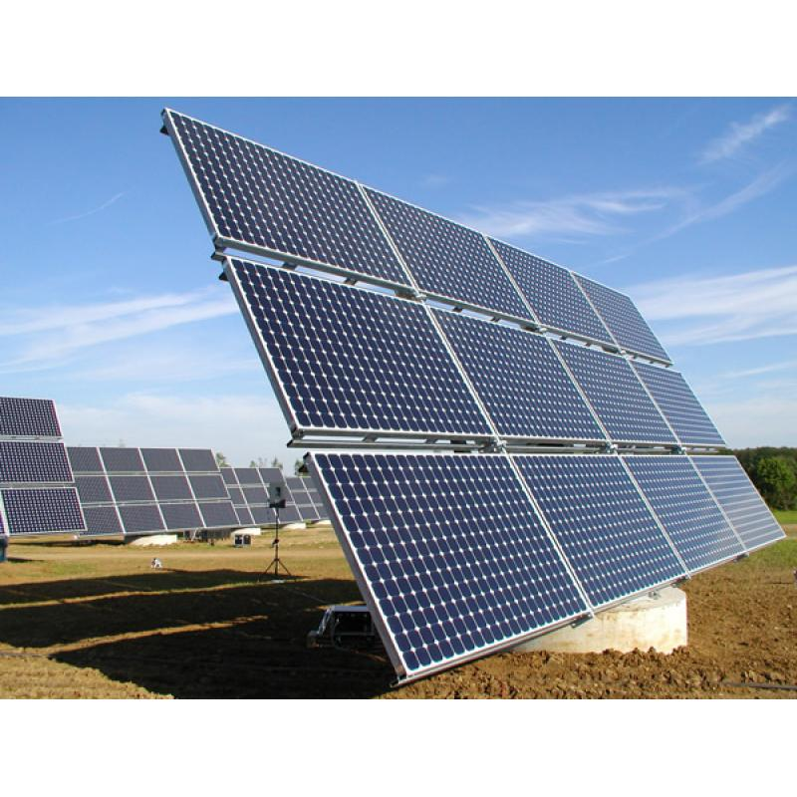
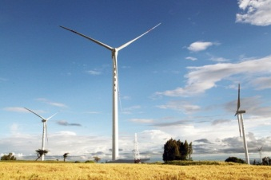
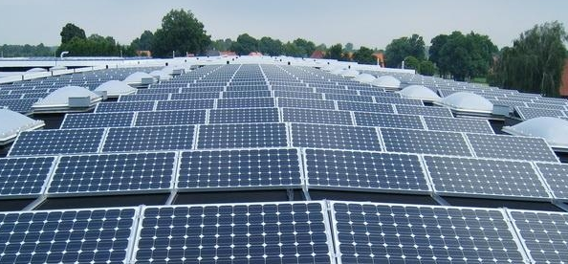
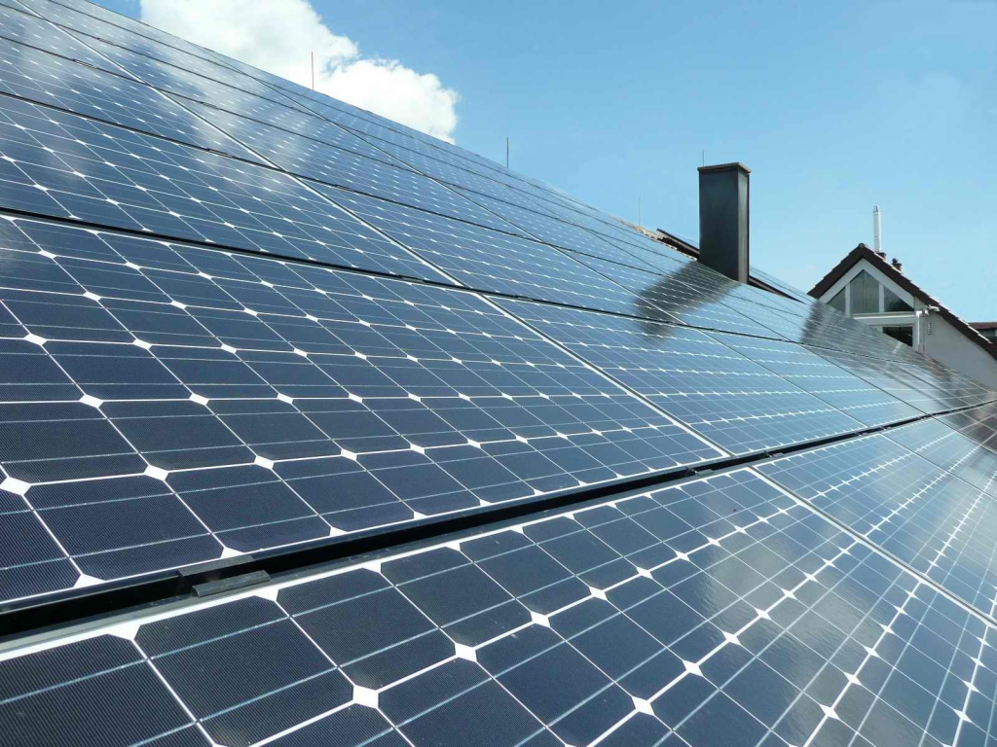
1
About POWERCHINA

Slide 4
About POWERCHINA
Overseas Business accounts for 25.7% and 53.61% of total business revenue and overall value of new contracts respectively.
USD 101.34 Billion
TOTAL ASSETS
25.7%
53.61%
Total Assets USD 101.34Billion.
230,000
Employees
18 PROVINCES
4 MUNICIPALITIES

Slide 5
About POWERCHINA
POWERCHINA was ranked 182th in Fortune Global 500 in 2018
The Top 250 Global Contractors (Rank 2018)
The Top 150 Global Design Firms (Rank 2018)
6
2
Good Credit Ratings in 2018
A-
Baa1
BBB+

Slide 6
About POWERCHINA
Several Prestigious International Brands
As POWERCHINA’s subsidiaries, SINOHYDRO, HYDROCHINA, SEPCO, SEPCOIII, etc. all have professional expertise, rich experience, and high reputation in its relative filed worldwide.

Slide 7
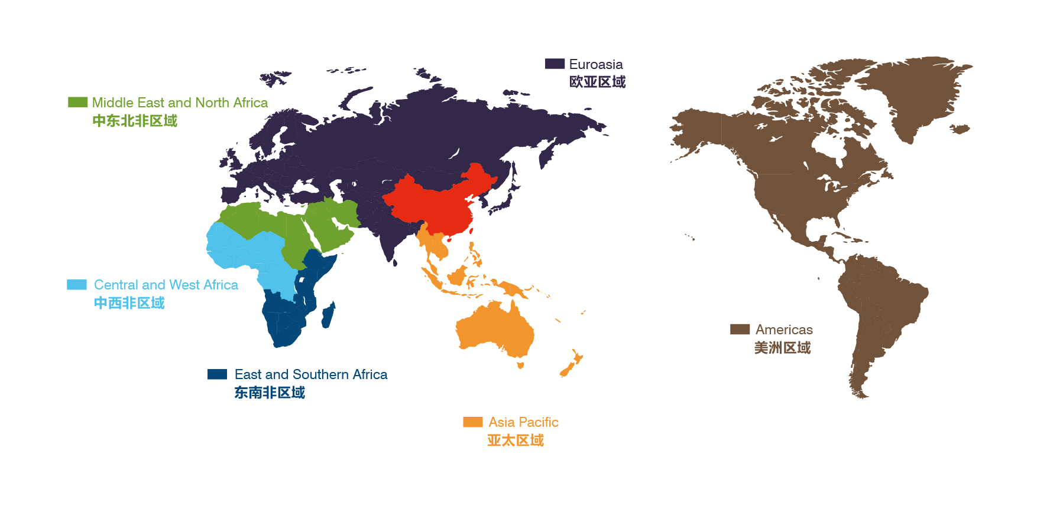
About POWERCHINA
224 Branches in 101 Countries
Istanbul, Turkey
Dubai, UAE
Abidjan，Ivory Coast
Panama City, Panama
Nairobi，Kenya
Kuala Lumpur， Malaysia
6 Regional Headquarters

Slide 8
About POWERCHINA
Hydropower
Real Estate
survey, planning, design, consulting
construction
equipment manufacture
equipment installation
operation & maintenance
Investment/financing
survey, planning, design, consulting
construction
equipment manufacture
equipment installation
operation & maintenance
Investment/financing
EPC
Thermal Power
Infrastructure
survey, planning, design, consulting
construction
equipment manufacture
equipment installation
operation & maintenance
Investment/financing
PPP
EPC+F/
investment
survey, planning, design, consulting
construction
equipment manufacture
equipment installation
operation & maintenance
Investment/financing
POWERCHINA
BT
BOT
Transmission & Distribution
New Energy
survey, planning, design, consulting
construction
equipment manufacture
equipment installation
operation & maintenance
Investment/financing
survey, planning, design, consulting
construction
equipment installation
operation & maintenance
Investment/financing

Slide 9
2
Global New Energy Outlook

Slide 10
2.Global New Energy Outlook
Total primary energy consumption of the world
and the proportion of fossil energy
Notes:
这张图：从1965-2017年全球能源消费中 一次能源Primary Energy（黄色）消费量，和化石能源消费量在一次能源中的占比（蓝色）。单位（tce 吨标准煤）。想表明一个趋势：化石能源消费在总的能源消费占比中，逐年降低。 注：一次能源是指直接取自自然界没有经过加工转换的各种能量和资源,它包括：原煤、原油、天然气、油页岩、核能、太阳能、水力、风力、波浪能、潮汐能、地热、生物质能和海洋温差能等等。其中一次能源可以进一步分为再生能源和非再生能源两大类；二次能源,例如：电力、蒸汽、煤气、汽油、柴油、重油、液化石油气、酒精、沼气、氢气和焦炭等等

Slide 11
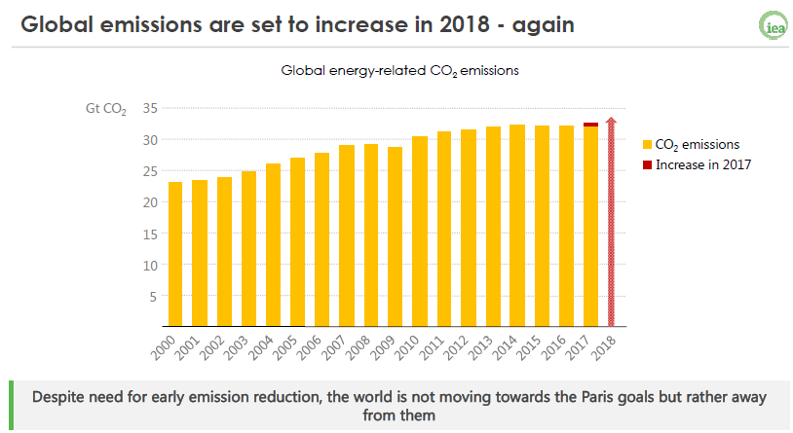
2.Global New Energy Outlook
Notes:
IEA的报告指出，全球碳排放量仍在逐年递增，尽管都在呼吁减少排放，但距离巴黎气候协定目标越来越远。

Slide 12
2.Global New Energy Outlook
BP Primary Energy Consumption Outlook for 100 years
Notes:
英国BP的预测，2000-2100年 一次能源消费结构将发生巨大变化，风光等可再生能源将成为主要能源消费来源。 以上充分表明新能源发展在未来能源领域的重要性。

Slide 13
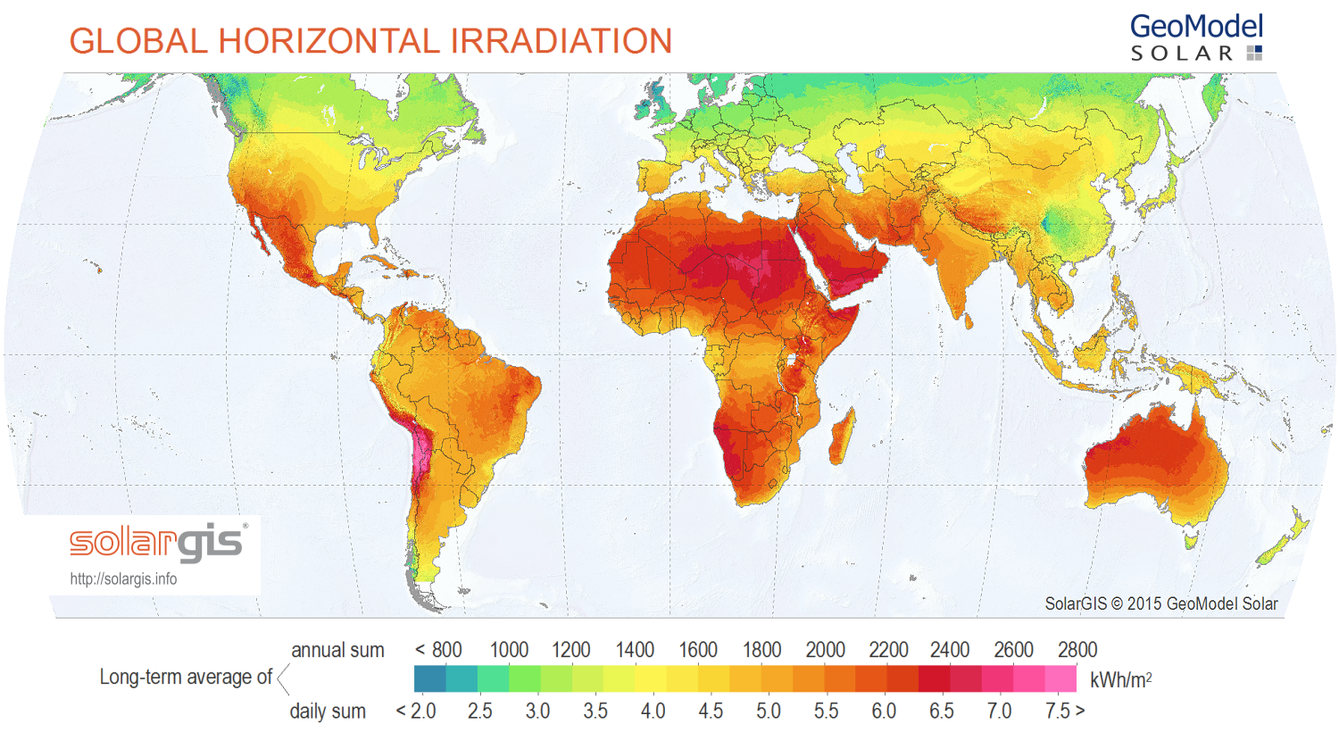
2.Global New Energy Outlook
Global Solar Map
Notes:
GHI 全球光资源图谱，包含（光直射、光散射、光反射）

Slide 14
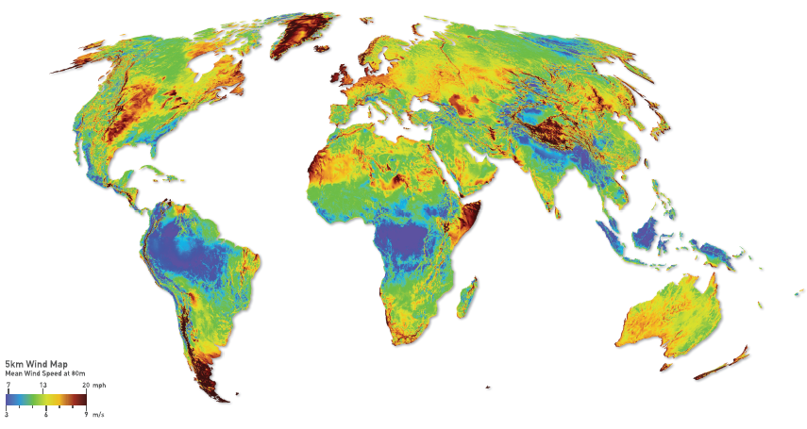
2.Global New Energy Outlook
Global Wind Map（80m）
Notes:
全球80米高度风能资源图谱 两个图谱可以看出全球拥有丰富的光资源与风资源

Slide 15
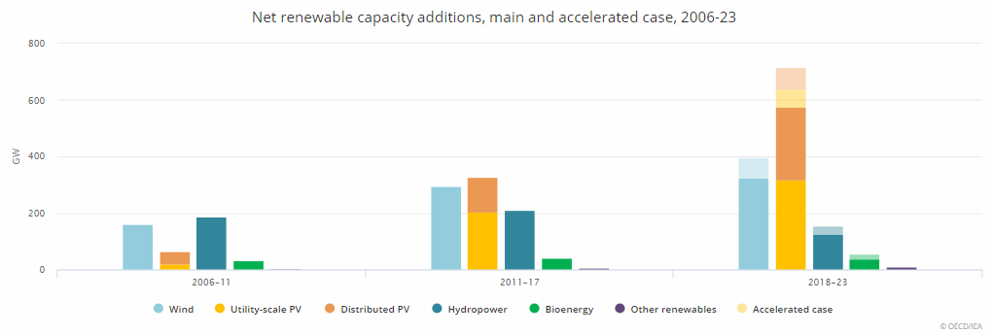
2.Global New Energy Outlook
Renewable Capacity Additions Forecast(IEA)
Notes:
2018年IEA全球能源报告中，对未来2018-2023年新增新能源装机规模进行预测，深色表示预测新能源装机增量，浅色表示发展加速情况下的预测。可以看到未来将有近1TW的新能源新增装机，其中光伏贡献了50%以上的份额。还有一部分水电和生物质发电及其它。
In the main case forecast, which takes into account prevailing market and policy framework, renewable capacity is expected to grow by over 1 TW, a 46% growth over the period 2018 to 2023. PV accounts for more than half of this expansion, driven by supportive government policies and market improvements across most regions.
In this forecast, wind remains the second-largest contributor to renewable capacity growth, followed by hydropower and bioenergy. Wind capacity is expected to expand by 60%, or 324 GW, with offshore wind accounting for 10% of that growth. Growth prospects for hydropower and bioenergy are both slightly more optimistic than last year, mostly owing to developments in China.
In an accelerated case forecast, which illustrates how some market and policy enhancements could affect renewable deployment, the growth in renewable capacity to 2023 could be 25% higher than in the main case, reaching 1.3 TW, provided that governments address policy, regulatory and financial challenges before 2020. China, India, the European Union and the United States together account for almost two-thirds of additional capacity growth in the accelerated case.
Solar PV alone represents half of the additional growth in this accelerated case. PV annual additions are expected to reach 140 GW by 2023, driven by faster cost reductions, which improve the technology’s global competitiveness.

Slide 16
2.Global New Energy Outlook
Solar Capacity Additions Forecast
Solor capacity is forecast to grow by 575 GW and reach 978 GW by 2023
Notes:
太阳能将主导未来5年可在生能源增长，而分布式太阳能发电将以更快的速度发展。目前仅中国一个国家几乎占据了45%全球太阳能市场扩张份额，某种程度上讲，光伏发展受中国光伏行业政策影响较大。近期中国政府决定逐步取消上网电价补贴（FIT）,中国的太阳能发展预计将要放缓，与2017年的增长相比，短期内全球需求将略微放缓。另一方面，全球太阳能发电成本在剧烈竞争中逐步降低，同时商业、住宅、离网光伏应用不断增加，都会成为太阳能行业不断扩张的推动力。不可忽视的是，除中国、美国、印度和日本以外，拉丁美洲及非洲的太阳能需求亦会持续增长。

Slide 17
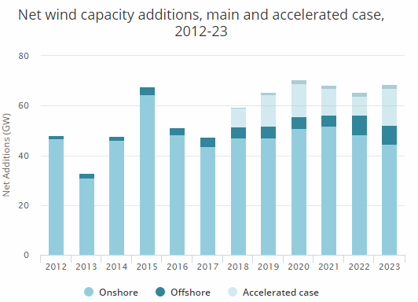
2.Global New Energy Outlook
Wind Capacity Additions Forecast
Wind capacity is forecast to grow by 324 GW and reach 839 GW by 2023
Notes:
未来5年海上风电的份额将不断增加，预计占未来风电新增装机10%。预计陆上风电每年新增装机为50GW，随着美国联邦税收优惠政策逐步减少，中国风电补贴减少以及大规模风电最电网的冲击，还有欧洲电力竞价拍卖不断普及，风电增长时态将区域稳定。海上风电装机到2023年将接近52GW，这一半的份额将来自于欧洲，剩下部分有中国和其它亚洲国家贡献。

Slide 18
2.Global New Energy Outlook
Pumped Storage Plant Global Status
Global PSP Capacity 153,041 MW
East Asia and Pacific 66,454 MW
Europe 51,769 MW
North America 22,986 MW

Slide 19
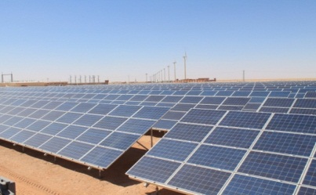
3
Win-Win Corporation

Slide 20
3.Win-Win Corporation
Corporation with Industrial/Financial Investors
Model 1
Corporation with Equipment Suppliers
Model 2
Corporation with Financial Institutions
Model 3
Notes:
这部分介绍新能源的合作共赢 从三方面合作介绍 分为：与财务/产业投资人合作、 与设备供应商合作、与金融机构合作

Slide 21
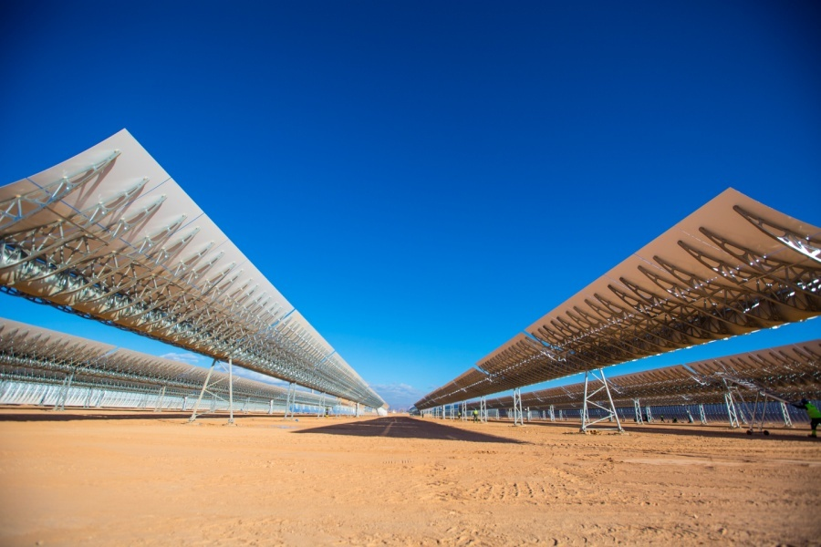
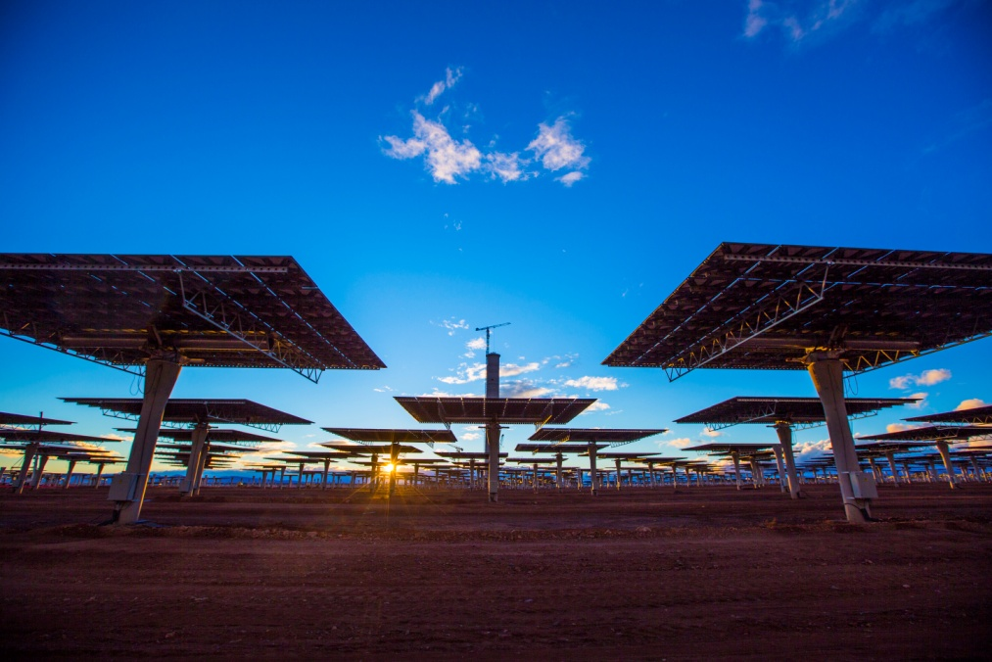
3.Win-Win Corporation
Corporation with Industrial/Financial Investors
Model 1
ACWA + POWERCHINA
Morocco Noor II&III CSP (200MW+150MW)
Investor: MASEN+ACWA
Contractor:
Powerchina+SENER
Notes:
与ACWA合作 努奥II&III期项目

Slide 22
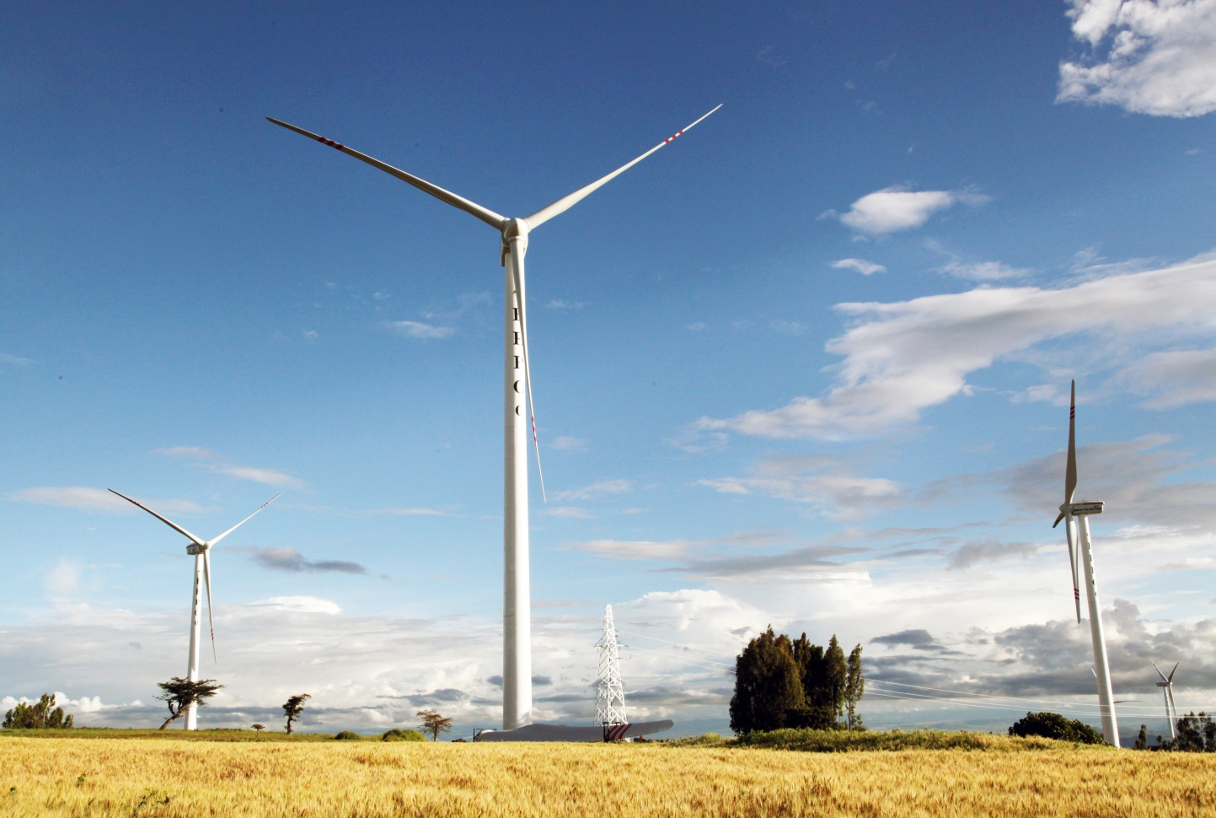
3.Win-Win Corporation
Corporation with Equipment Suppliers
Model 2
Goldwind + POWERCHINA
Argentina Loma Blanca Wind Farms (355MW)
Investor: Goldwind
Contractor: Powerchina
Wind turbine: Goldwind
Notes:
与金风合作 罗马布兰卡355MW风电项目

Slide 23
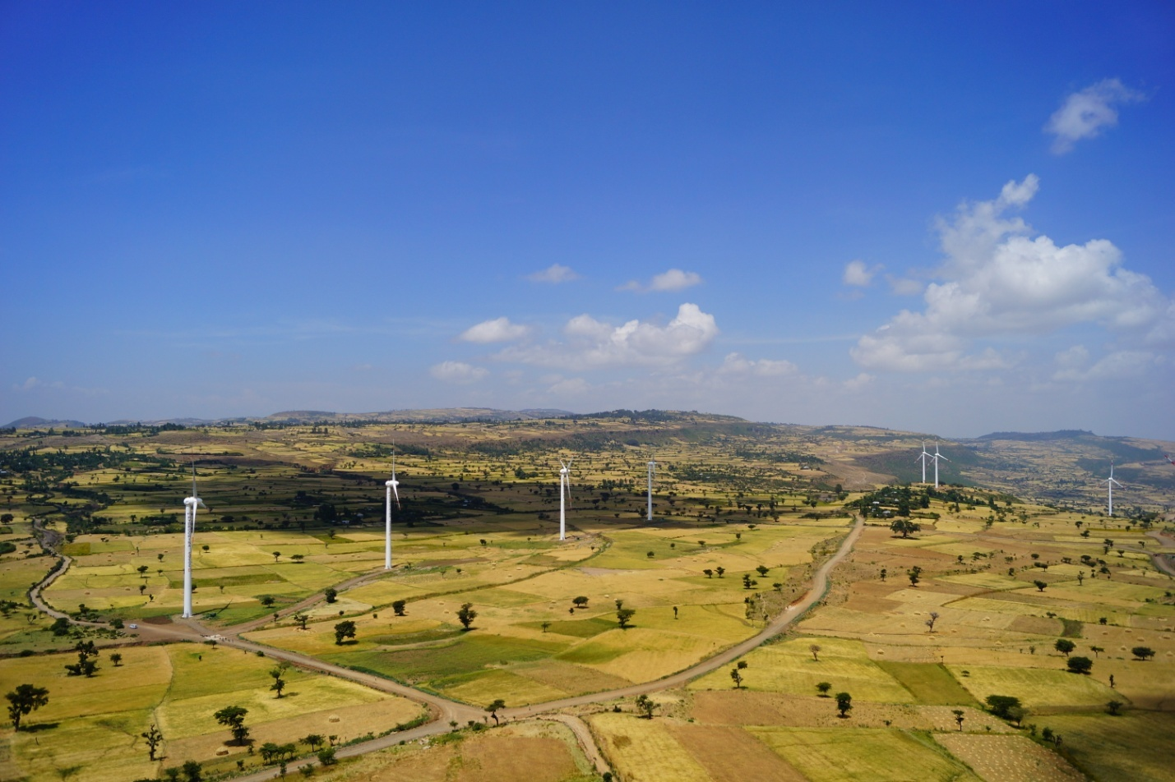
3.Win-Win Corporation
Corporation with Financial Institutions
Model 3
EXIM + POWERCHINA
Ethiopia Adama Wind Farm I &II (51MW+153MW)
Financed By EXIM Bank of China & Sinosure
Notes:
与口行信保合作 阿达玛I&II期 风电项目

Slide 24
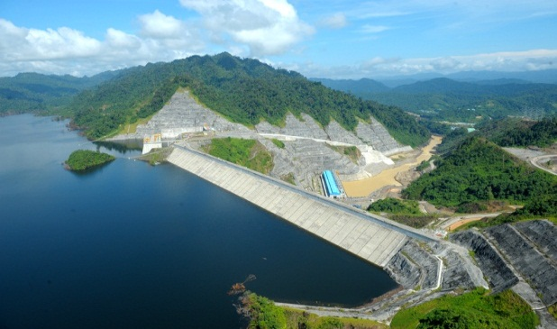
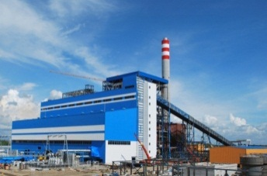
Thank You for Your Attention!

